Slide 1
BITWISE OPERATORS

Slide 2
In computing ,data at the processing level is represented in bits.
A bit (binary digit) is the smallest unit of data that a computer can process and store.
A bit is always in one of two physical states, similar to an on/off light switch.
The state is represented by a single binary value, Either a 0 or 1.
Thus in order for the computer to manipulate data it has to do so bit by bit.

Slide 3
Bits are usually assembled into a group of eight to form a byte. One byte is made up of eight bits
Computer storage and memory is often measured in megabytes (MB) and gigabytes (GB).
1 GB is 1,024 MB, or 1,073,741,824 (1024x1024x1024) bytes.
For mathematical representation we humans count in base 10 by powers of 10:
  10¹ = 10
  10² = 10*10 = 100
  10³ = 10*10*10 = 1,000
  10⁶ = 1,000,000

Slide 4
But Computers count by base 2:
  2¹ = 2
  2² = 2*2 = 4
  2³ = 2*2*2 = 8
  2¹⁰ = 1,024
  2²⁰ = 1,048,576

Slide 5
But also in computing a Hexadecimal number system is used.
Hexadecimal -- also known as Base 16 or hex -- is one of four numbering systems.
The other three are decimal (base 10), binary (base 2) and octal (base 10) .
In computing systems, the binary string equivalents of large decimal numbers can become quite long.
This problem can be overcome by arranging the binary numbers into groups of four bits, i.e., by using the hexadecimal numbering system.

Slide 6
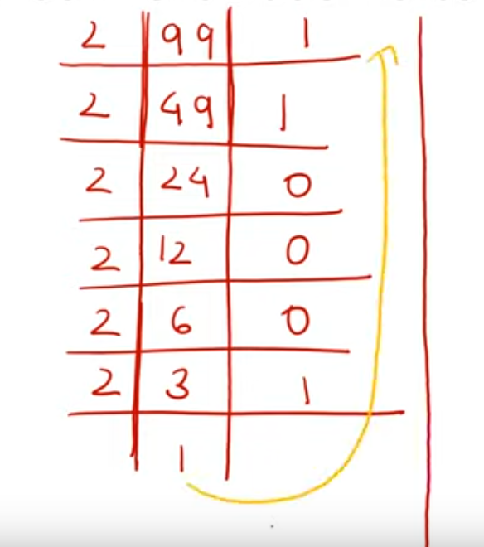
Conversion from base 10 to base 2 (from decimal to binary)
eg : 99
ans = 11000112

Slide 7
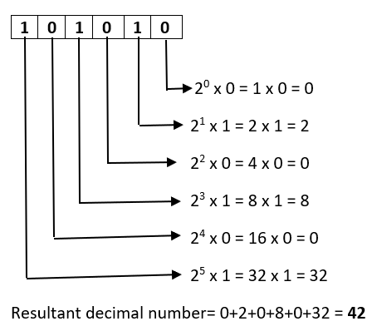
Conversion from base 2(binary) to base 10(decimal)
eg : 1010102 to its decimal equivalent
ans : 4210

Slide 8
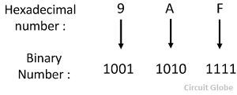
Hexadecimal to Binary Conversion
Base 16(hexa) to Base 2
To convert a hexadecimal number to a binary number, convert each hexadecimal digit to its four digit binary equivalent.
Example, the hexadecimal number 9AF
Therefore the equivalent binary number is 100110101111.

Slide 9
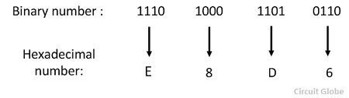
Binary to Hexadecimal Conversion
Base 2 to Base 16.
To convert the any given binary number into its equivalent hexadecimal number rewrite the binary number into sets of four digits.
Then map each set of four to its equivalent hexadecimal number.
Eg : 11101000110101102
Thus the equivalent hexadecimal number is E8D6.

Slide 10
Bitwise Operators in C Programming
To perform bit-level operations in C programming, bitwise operators are used.
  & Bitwise AND
  | Bitwise OR
  ^ Bitwise XOR
  ~ Bitwise complement
  << Shift Left
  >> Shift Right

Slide 11
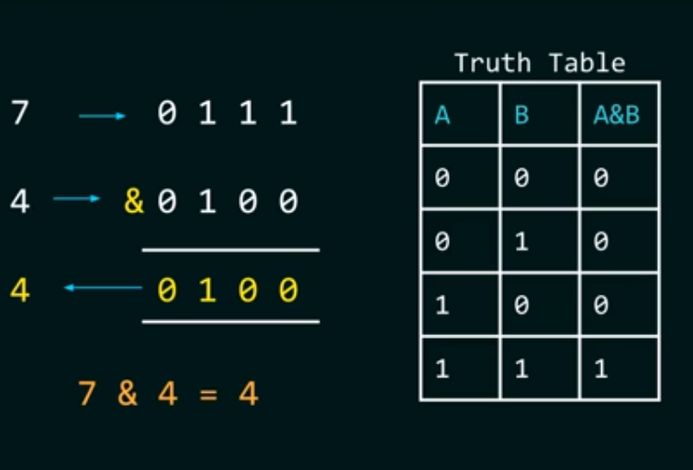
Bitwise AND Operator &
It takes two bits at a time and performs an AND operation.
AND(&) is a binary operator meaning it requires two operands.
The result of AND is 1 when both bits are 1.

Slide 12
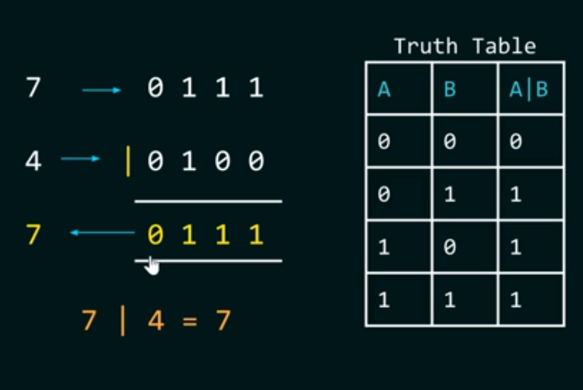
Bitwise OR Operator |
It takes two bits at a time and performs an OR operation.
OR | is a binary operator meaning it requires two operands.
The result of OR is 0 when both bits are 0.

Slide 13
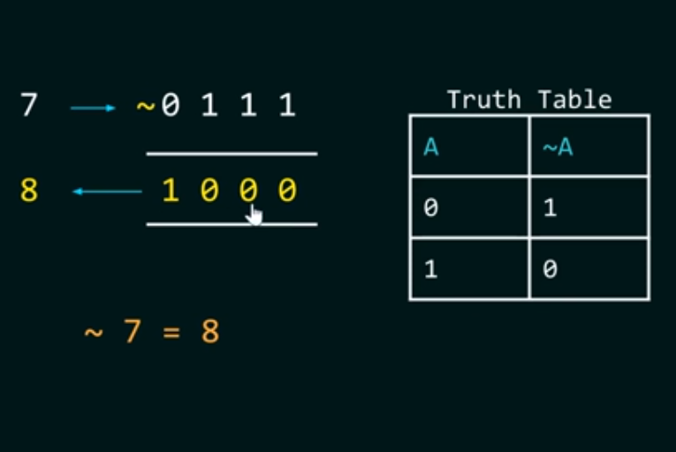
Bitwise NOT Operator ~
NOT is a unary operator
Its job is to complement each bit one by one
When the bit is 1 NOT returns a result of 0 Else if the bit is 0 NOT returns a result of 1

Slide 14
Left Shift Operator <<
The left shift operator is a binary operator therefore it requires 2 operands
first operand << second operand
The first operand is the one whose bits are being left shifted.
The second operand is the one that decides the number of places to shift the bits.
Note : once bits are shifted,trailing positions are filled with zeros

Slide 15
Example: 3 << 1
3 in binary represented using 8 bits : 0000 0110
Thus 3 << 1 means : shift 0000 0011 by one position to the left
once shifted : 0000 0011 becomes 0000 0110
0000 0110 in decimal is 6
Thus 3 << 1 is 6
Example: 0x01 << 1
0x01 in binary is 0000 0001
Thus 0x01 << 1 means : shift 0000 0001 by one position to the left
once shifted : 0000 0001 becomes 0000 0010
0000 0010 in hexadecimal is 0x02
Thus 0x01 << 1 is 0x02

Slide 16
Right Shift Operator >>
The Right shift operator is a binary operator therefore it requires 2 operands
first operand >> second operand
The first operand is the one whose bits are being right shifted.
The second operand is the one that decides the number of places to shift the bits.
Note : once bits are shifted,the leading positions are filled with zeros

Slide 17
Example: 3 >> 1
3 in binary represented using 8 bits : 0000 0011
Thus 3 >> 1 means : shift 0000 0011 by one position to the right
once shifted : 0000 0011 becomes 0000 0001
0000 0001 in decimal is 1
Thus 3 >> 1 is 1
Example: 0x02 >> 1
0x02 in binary is 0000 0010
Thus 0x02 >> 1 means : shift 0000 0010 by one position to the right
once shifted : 0000 0010 becomes 0000 0001
0000 0001 in hexadecimal is 0x01
Thus 0x02 >> 1 is 0x01

Slide 18
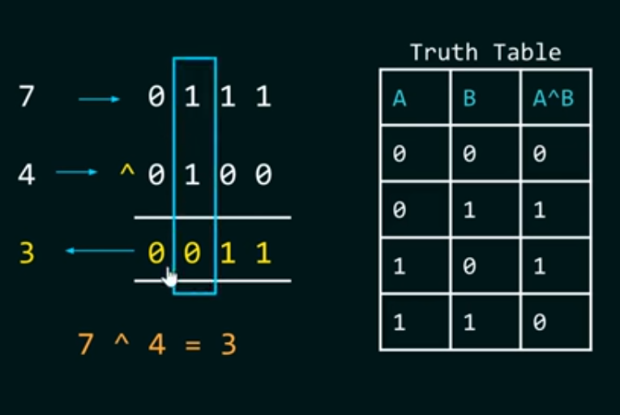
Bitwise XOR Operator ^
Exclusive OR operator concludes that when both bits are 1 the output is zero.

Slide 19
  ~ Bitwise complement
Bitwise complement operator is a unary operator (works on only one operand). It changes 1 to 0 and 0 to 1.
35 = 00100011 (In Binary)
Bitwise complement Operation of 35
~ 00100011
________
11011100
#include <stdio.h>
int main()
{
printf("Output = %d\n", ~35);
printf("Output = %d\n", ~-12);
return 0;
}

Slide 20
Example :
  ~ 0x12
0x12 in binary is 00010010
once the complement is done 00010010 becomes 11101101
11101101 in hexadecimal is 0xED
Thus ~ 0x12 is 0xED

